Slide 1

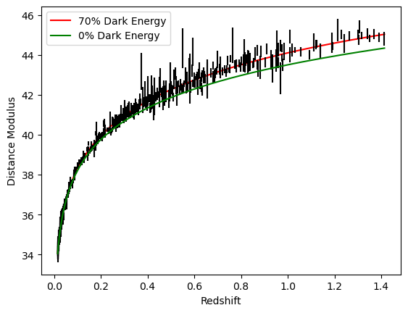
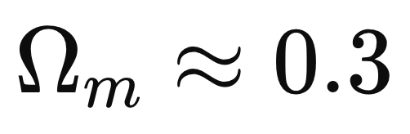
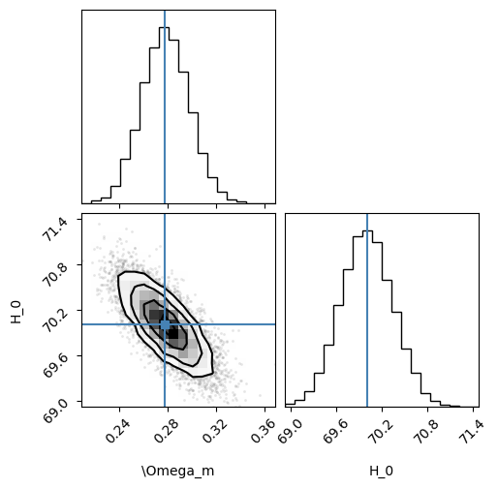

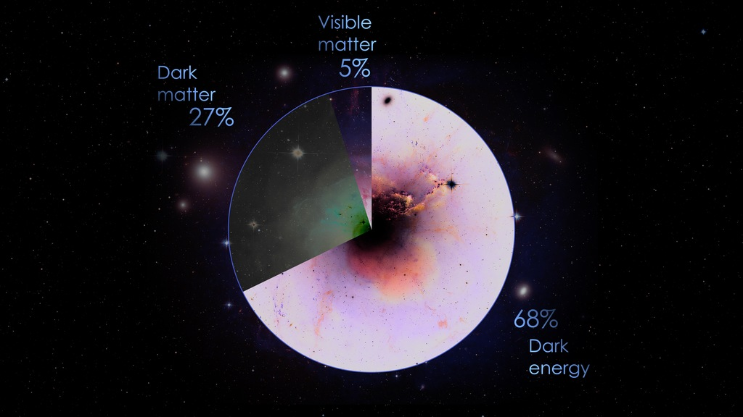
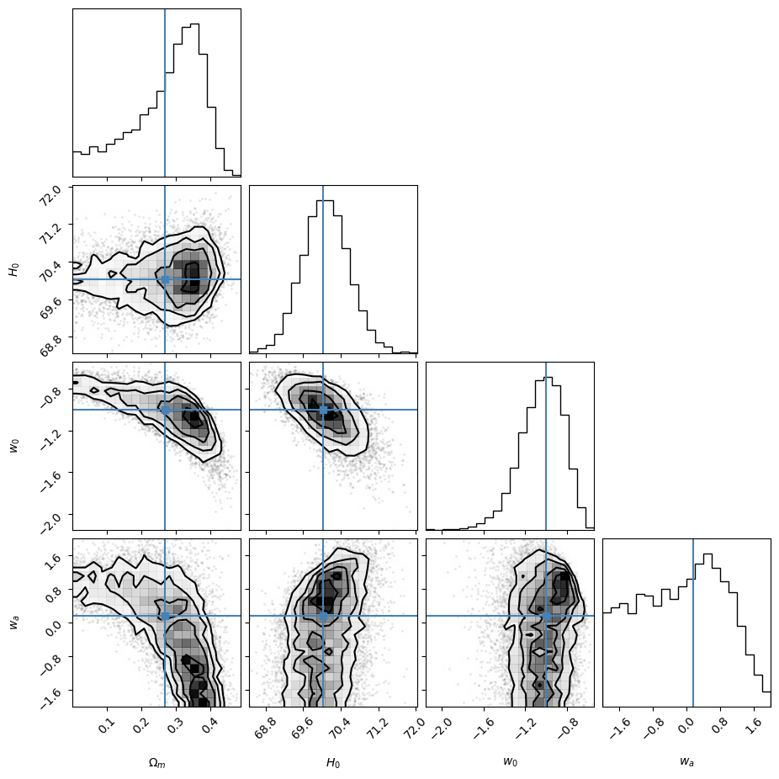
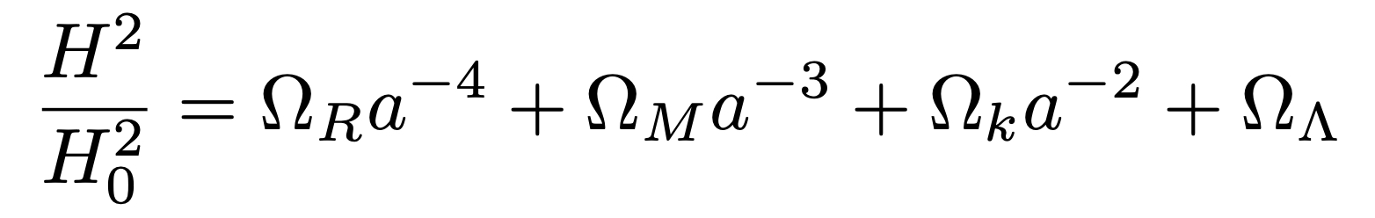

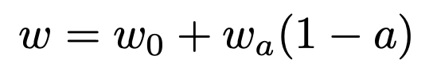
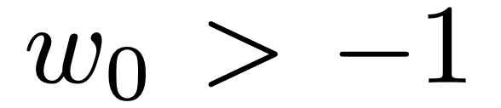
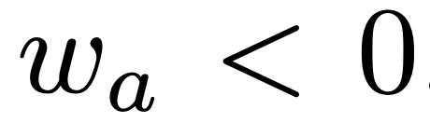


Dark Energy with Type 1a Supernovae
Mentor: Nihar Dalal
Background
Our Results
Using data from the Supernova Cosmology Project, we found the Hubble constant to describe the expansion rate of the universe and aimed to determine the matter density of the universe. Using the calculated Hubble constant, we were able to prove the existence of dark energy in the universe and analyze an evolving dark energy parameter. The scientists who lead this advancing research were awarded a Nobel prize in 2011. This data has proved an accelerating universe and has pushed further research into the question of “what is dark energy?”
By using data from the Supernova Cosmology Project, we were able to fit the data to model with a minimum chi ^2 matter density parameter of leaving a 70% dark energy density parameter. In comparison to a 0% dark energy model, we can see that it does not fit the data well.
(1)
Type 1a Supernovae
To get more accurate errors and learn the method we used MCMC to do a parameter estimation that produces maximum likelihood estimates of 0.268 and 70.031 for and H0. Plot 2 shows the best fitting parameters as a result of MCMC whilst assuming constant dark energy density. This data shows an H0 value of 70 in a universe that contains dark energy and an value of 0.3.
This supernovae consists of a white dwarf star and a companion star. When orbiting each other, they become increasingly unstable and eventually the white dwarf will exceed its critical mass, creating an explosion. We used Type 1a Supernovae in our work because they have a fixed brightness which makes it easier to locate and determine the distance of. As part of this project, we analyzed their redshift to determine how the distances between each supernova change throughout time.
Components of the Universe
(2)
The universe is composed of radiation, ordinary matter, dark matter, and dark energy but is dominated by matter density and dark energy density parameters. With a calculated curvature (k) value of 0, the universe is also presumed to be flat and infinite. This model of the universe is known as Lambda CDM Cosmology.
By introducing a W0 and Wa parameter, we used MCMC to do a parameter estimation assuming evolving dark energy. We found similar maximum likelihoods and a w0 value equal to -1 and a Wa value equal to 0.145. However, plot 3 shows that when assuming
(1)
evolving dark energy, we do not get parameters that fit the data well. The supernova data is not strong enough to distinguish evolving dark energy.
Evolving Dark Energy?
In the reworked Friedmans equation shown above (1) we can recognize the dark energy density parameter as . It exists in the equation as a constant value. However, by analyzing the parameter as a non-constant value we effectively change the evolution of the universe. The equation of state of dark energy can be changed to hold an expansion scale of a = 1 along with a cosmological constant of w = -1 to get the following equation of state parameter .
DESI is able to measure the cosmic factor scale by using the Baryonic Acoustic Oscillation scale. Results from DESI have pointed to a model which supports evolving dark every with and
(3)
Bibliography/ Acknowledgements
(2)
We would like to thank the developers of Astropy and emcee Markov Chain Monte Carlo
Astropy Collaboration et al., 2018
The Astropy Project: Building an Open-science Project and Status of the v2.0 Core Package
Foreman-Mackey, D., Hogg, D. W., Lang, D., & Goodman, J. (2013). emcee: The MCMC Hammer. Publications of the Astronomical Society of the Pacific, 125(925), 306–312.
We would also like to thank the team of scientist who worked on the Supernova Cosmology Project
“Supernova Cosmology Project.” Supernova Cosmology Project, supernova.lbl.gov/. Accessed 16 Apr. 2025.
Notes:
Change:
Title
Add CEM/NSF logos
Authors
All Figures
Motivation
NZAFO Background
ODFMR background
Add Spinwave Instability Background
Fix Bibliography
Fix Acknowledgements
Fix Future Direction
Add Discussion

